Slide 1
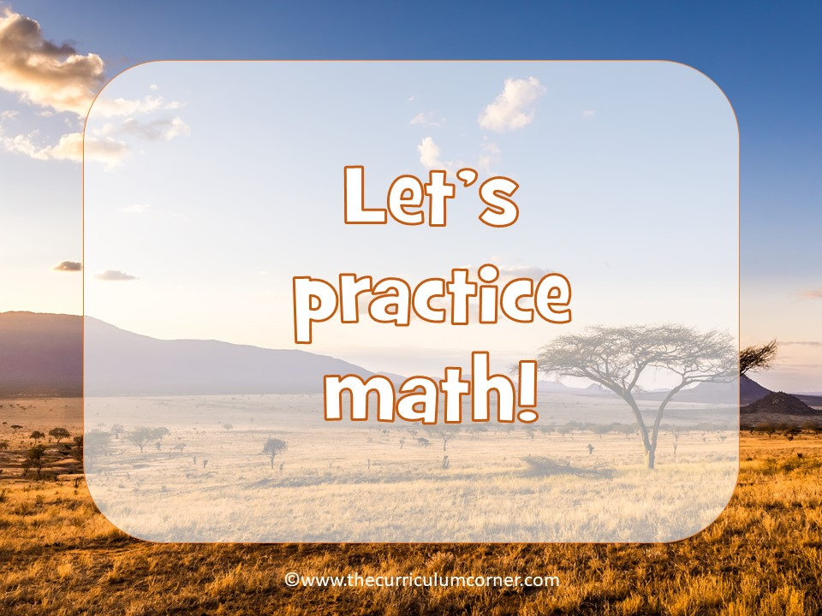

Slide 2
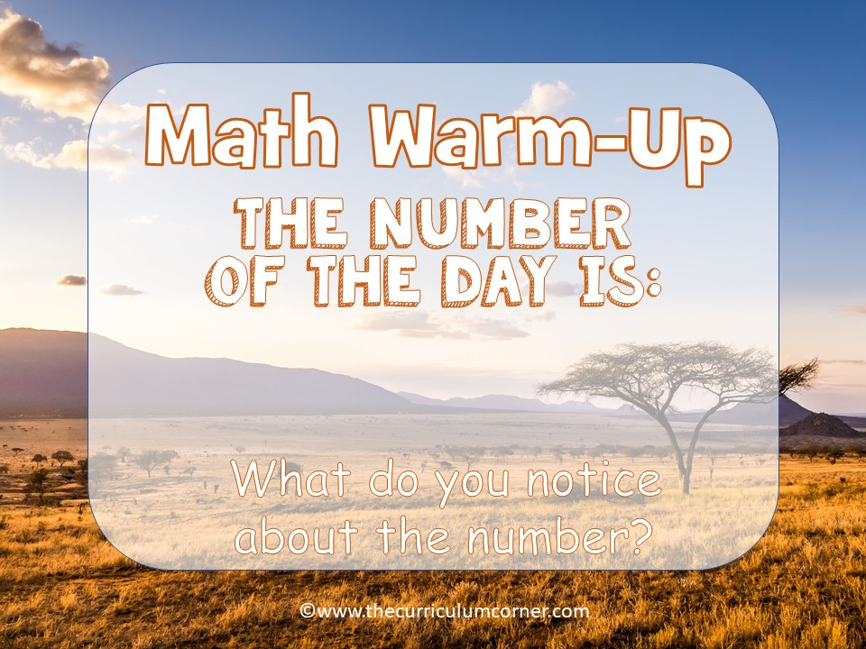
17,628

Slide 3

17,628
Write answers here

Slide 4
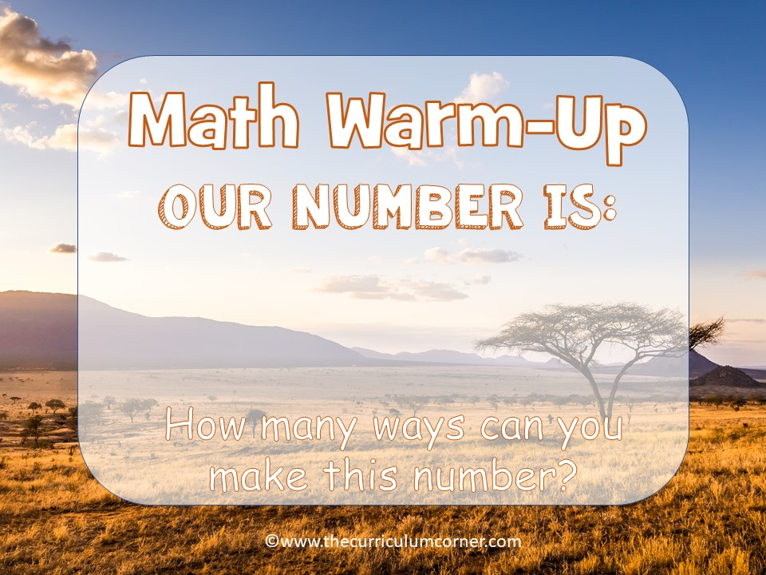
17,628

Slide 5

17,628
Write answers here

Slide 6


Slide 7

Write answers here

Slide 8
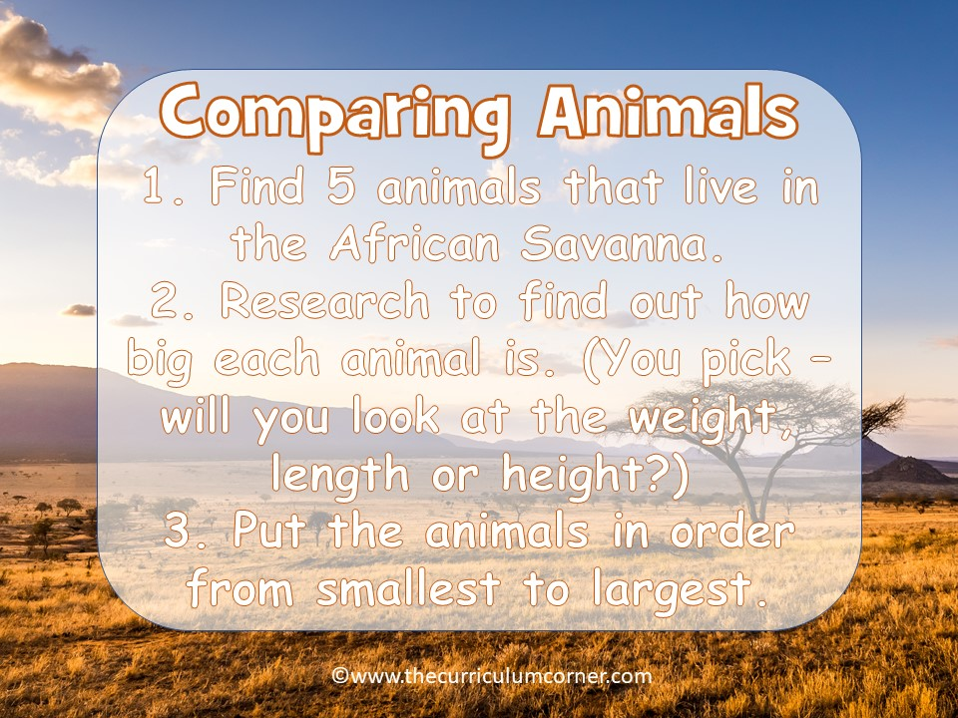

Slide 9
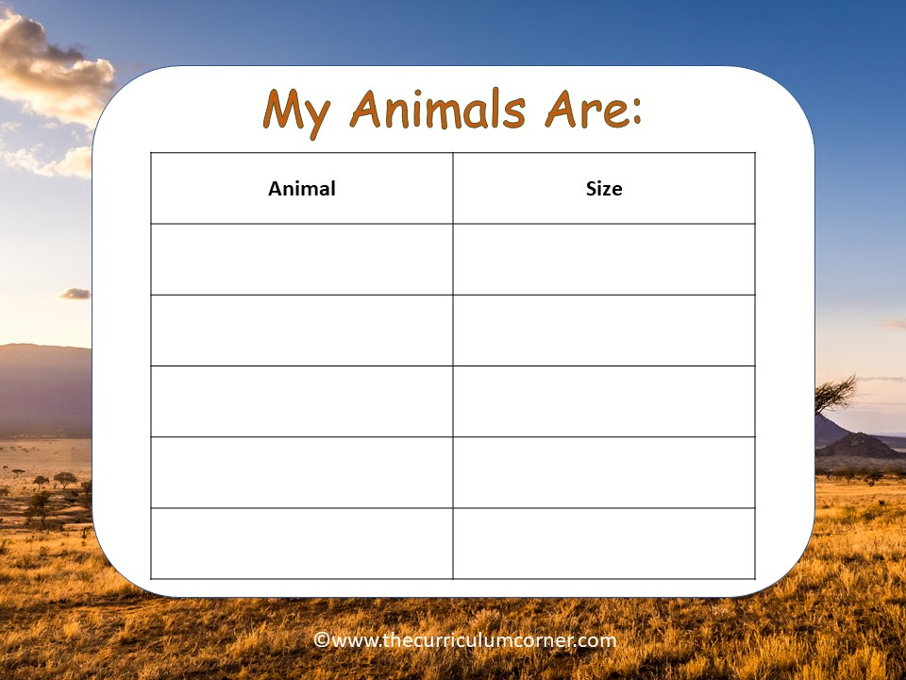
animal here | size here
animal here | size here
animal here | size here
animal here | size here
animal here | size here

Slide 10
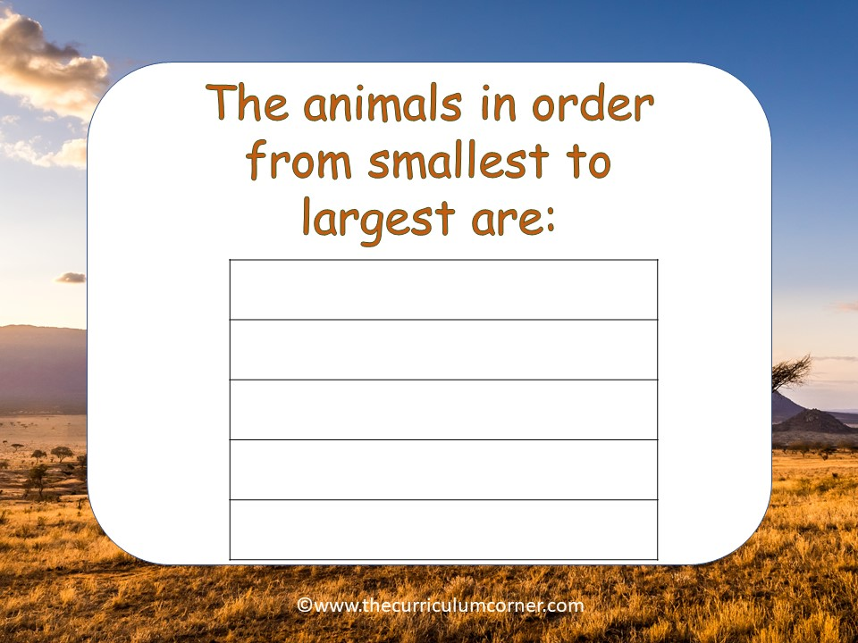
animal here
animal here
animal here
animal here
animal here

Slide 11
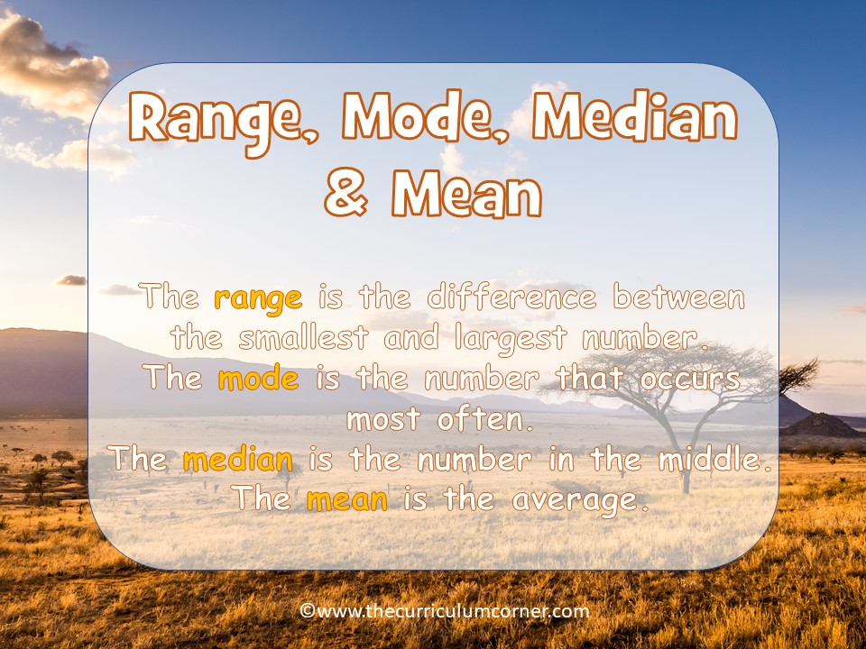

Slide 12
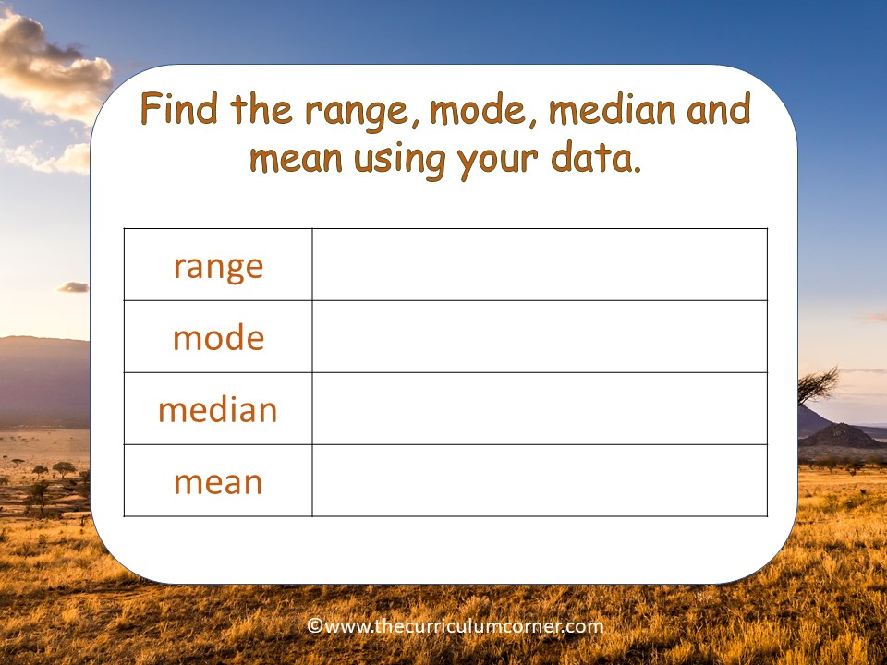
answer here
answer here
answer here
answer here
answer here

Slide 13


Slide 14
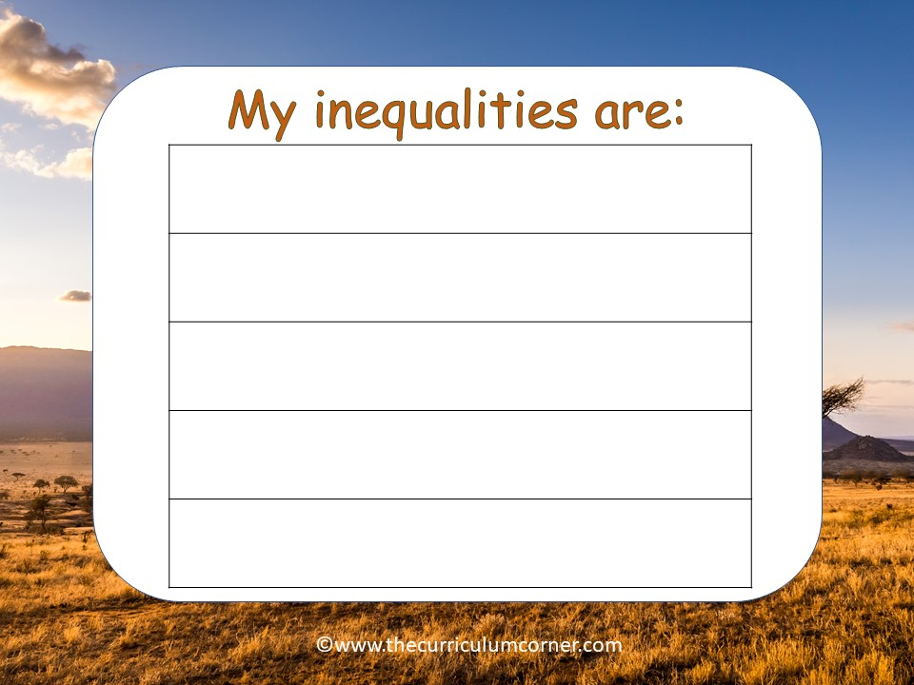
answer here
answer here
answer here
answer here
answer here

Slide 15


Slide 16

Write problem here

